Slide 1
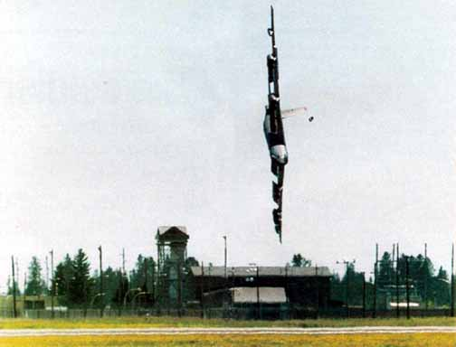
Case 3: The Leadership Imperative & “Darker Shades of Blue”, Part 1
Case Study: “Darker Shades of Blue”
LM 09-02 Czar 52 Crash 00min47sec.mp4
http://www.youtube.com/watch?v=YQa4PpIkOZU
http://www.youtube.com/watch?v=FUEhNKBi4DY&feature=related

